Slide 1
Multilateration Indexing
Data structures and algorithms to improve query performance for geodesic and other complex distance functions
Master’s Presentation - Chip Lynch, University of Louisville, Summer, 2021

Slide 2
Agenda
Hi, I’m Chip!
Problem Statement
Multilateration Index
Query Algorithms
Experiments
Results
Conclusions and Future Work

Slide 3
About Chip
Hi, I’m Chip!
Came back to grad school for “fun”
It’s been fun!
Did some research, took some classes. Good times.
Data and Software Engineer for:
KPMG / Deloitte
NASA
US Air Force
SpaceX
Passport Health (Medicare/Medicaid)

Slide 4
Problem
Statement
Real World Problems
Satellite Communications
Fast Moving
Extreme accuracy requirement over long distances for laser guidance
Regularly need to find the closes Satellite/Ground Station/User Terminal (Nearest Neighbor)
Healthcare Network Adequacy
Ensure that x% of <type of person> is within m miles of <type of health service>
80% of female members over the age of 13 must live within 25 miles of an OB/GYN
80% of members under the age of 16 must live within 25 miles of a pediatrician
90% of members must live within 50 miles of an emergency room
...

Slide 5
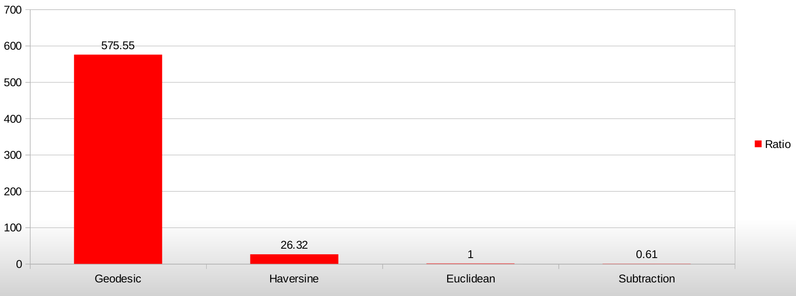
Problem
Statement
Expensive Distance Functions

Slide 6
Problem
Statement
Network Adequacy
Given a non-empty set of points P and a non-empty set of query points Q in a metric space M (where P ∩ Q comprises the ‘network’), the network is ‘completely adequate’ for a distance d and a distance function D(a, b) describing the distance between points a and b for a ∈ M and b ∈ M if for every point q (where q ∈ Q) ∃ at least one point p (p ∈ P ) 3 D(p, q) <= d. Otherwise the network is ‘inadequate.’
We call a single point q ‘adequate’ itself, if it satisfies the same condition – i.e. ∃ at least one point p (p ∈ P ) D(p, q) <= d.
If, within P , we consider the largest subset P’ ∈ P where P’ is ‘completely adequate,’ then P has a “Network Adequacy Percent (NAP)” of |P’|/|P|. Note that P’ can be defined (identically) as the union of all ‘adequate’ points p ∈ P

Slide 7
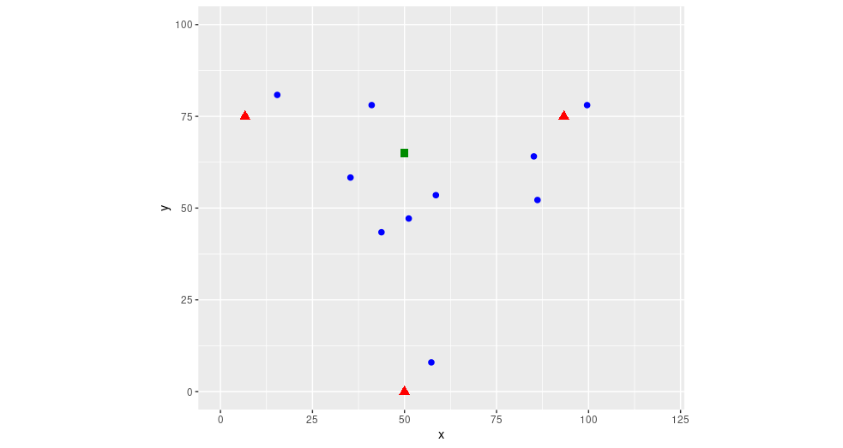
Problem
Statement
Nearest Neighbor
Given a set of search points P (blue dots), and a query point Q (green square), determine which of the points in P are closest to the query point Q

Slide 8
Problem
Statement
(Advanced) Nearest Neighbor
Constraints beyond typical NN problems:
Constant motion – pre-processing must happen repeatedly and quickly
Expensive distance function D(a, b)
Queries specify subsets of points in P and Q
Includes “kNN”:
Find the nearest k neighbors out of the set P

Slide 9
Problem
Statement
Comparing Solutions
Training Time Complexity
the O() (typically in terms of |P|) required to pre-process the points p if any
Memory Space
the memory requirements of the structures resulting from pre-processing
Prediction Time Complexity
the O() required to find the closest point p ∈ P for a single query point q
Insertion/Move Complexity
the O() complexity required to add or move (or remove) a point p ∈ P (or q ∈ Q)

Slide 10
Problem
Statement
Comparing Solutions
Training Time Complexity
the O() (typically in terms of |P|) required to pre-process the points p if any
Memory Space
the memory requirements of the structures resulting from pre-processing
Prediction Time Complexity
the O() required to find the kN N ∈ P for a single point q
Insertion/Move Complexity
the O() complexity required to add or move (or remove) a point p ∈ P
Most solutions optimize for #3

Slide 11
Problem
Statement
Existing NN Solutions
Brute Force
Compare every point to each other and sort the resulting distances
Space Partitioning Trees
Recursively divide points into smaller and smaller areas to reduce search space
Examples: k-d trees and ball trees
Locality Sensitive Hashing
Project points to lower dimensions while attempting to maintain distance relationships
Graph Based Search
Create a network of locally nearest-neighbors
Example: Facebook’s FAISS

Slide 12
Multilateration
Index
Proposing a Solution
The Multilateration Index
Store distances from fixed points, rather than coordinates
i.e. Store distances from three points around the globe for geospatial applications
Benefits:
Allows direct comparison of distances using simple subtraction
Can be quickly calculated and updated (particularly vs. graph and space partitioning)
Allows error checking (many combinations of distances are impossible, unlike coordinates)
Is easily augmented with additional data that does not affect optimization

Slide 13
Multilateration
Index
Example Index:
Index | x | y | d1 | d2 | d3
8 | 15.42852 | 80.83634 | 10.50105 | 78.09115 | 87.91872
4 | 35.32139 | 58.321179 | 33.12763 | 60.331164 | 60.14001
6 | 41.08036 | 78.065907 | 34.51806 | 52.310835 | 78.57382
2 | 43.7394 | 43.418684 | 48.67639 | 58.768687 | 43.86772
7 | 51.14533 | 47.157734 | 52.44704 | 50.520446 | 47.17164
1 | 58.52396 | 53.516719 | 56.10157 | 40.877779 | 54.1913
9 | 85.13531 | 64.090063 | 79.19169 | 13.627535 | 73.08916
5 | 86.12714 | 52.201894 | 82.6355 | 23.900247 | 63.48392
3 | 57.28944 | 7.950161 | 83.99465 | 76.108693 | 10.78615
10 | 99.60833 | 78.055071 | 92.95982 | 7.008032 | 92.48557

Slide 14
Algorithms
Example Walkthrough Step 1:
3 Red Triangles:
Reference Points
10 Blue Dots:
Search Points
1 Green Square:
Query Point

Slide 15
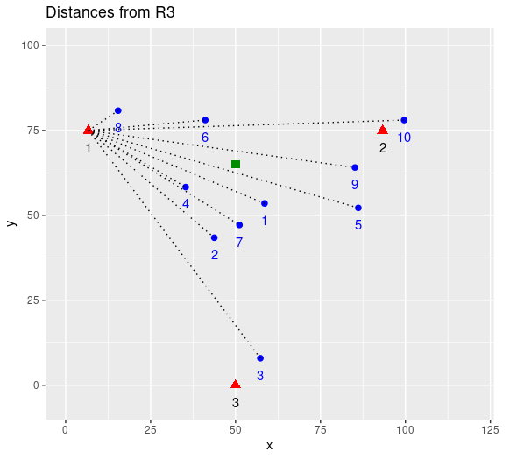
Algorithms
Example Walkthrough Step 2:

Slide 16
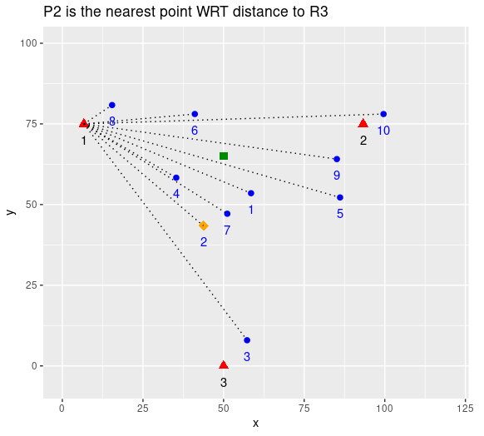
Algorithms
Example Walkthrough Step 3:

Slide 17
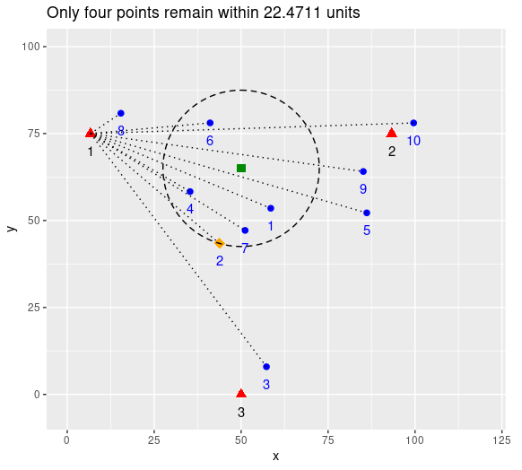
Algorithms
Example Walkthrough Step 4:

Slide 18
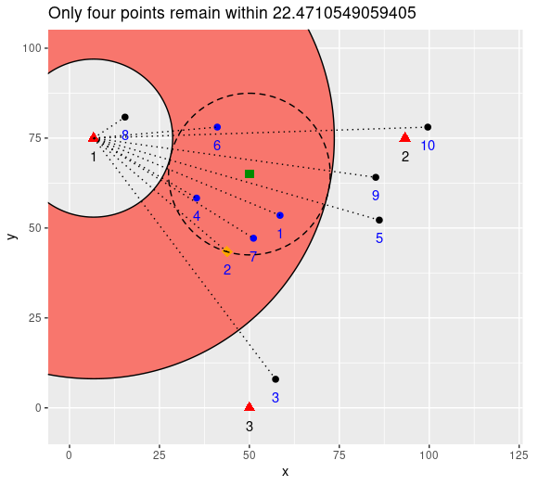
Algorithms
Example Walkthrough Step 5:

Slide 19
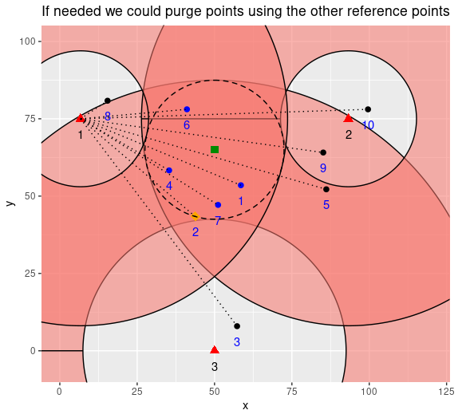
Algorithms
Example Walkthrough Step 6:

Slide 20
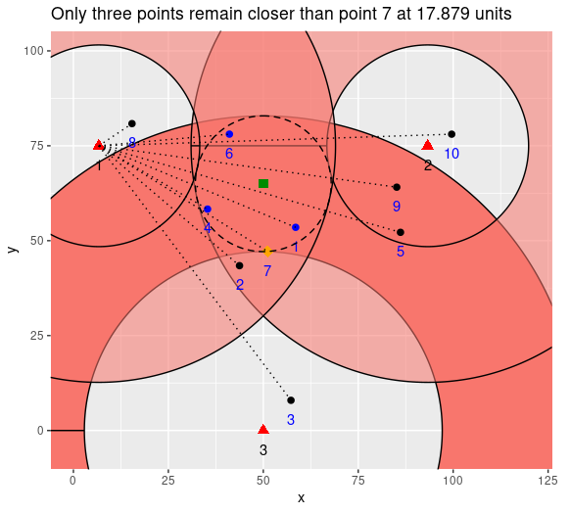
Algorithms
Example Walkthrough Step 7:

Slide 21
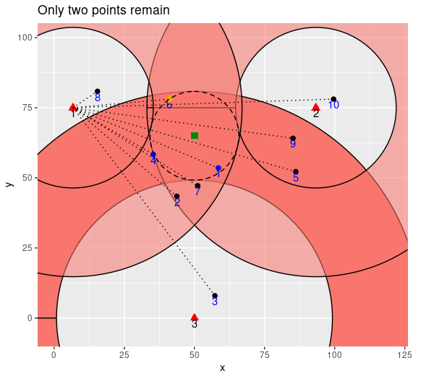
Algorithms
Example Walkthrough Step 8:

Slide 22
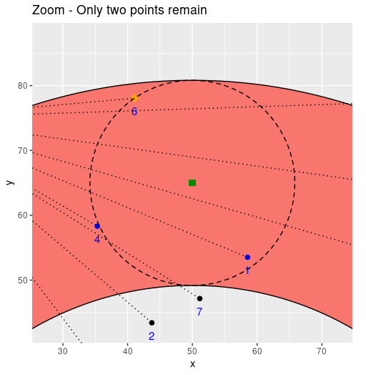
Algorithms
Example Walkthrough Step 9:

Slide 23
Experiments
Experiment Setup
Nearest Neighbor:
Use Open Source “ANN” Software
Modify popular Scikit-Learn to run our algorithms
Use custom geodesic data set (since none already existed)
Use existing Euclidean and Angular data sets for comparison
Network Adequacy:
Use Postgresql due to geodesic distance support
No strong alternatives exist in SQL so we compare to naive use of “st_distance”
Data
150,000 Points near Louisville, KY divided into 10 Categories when needed

Slide 24
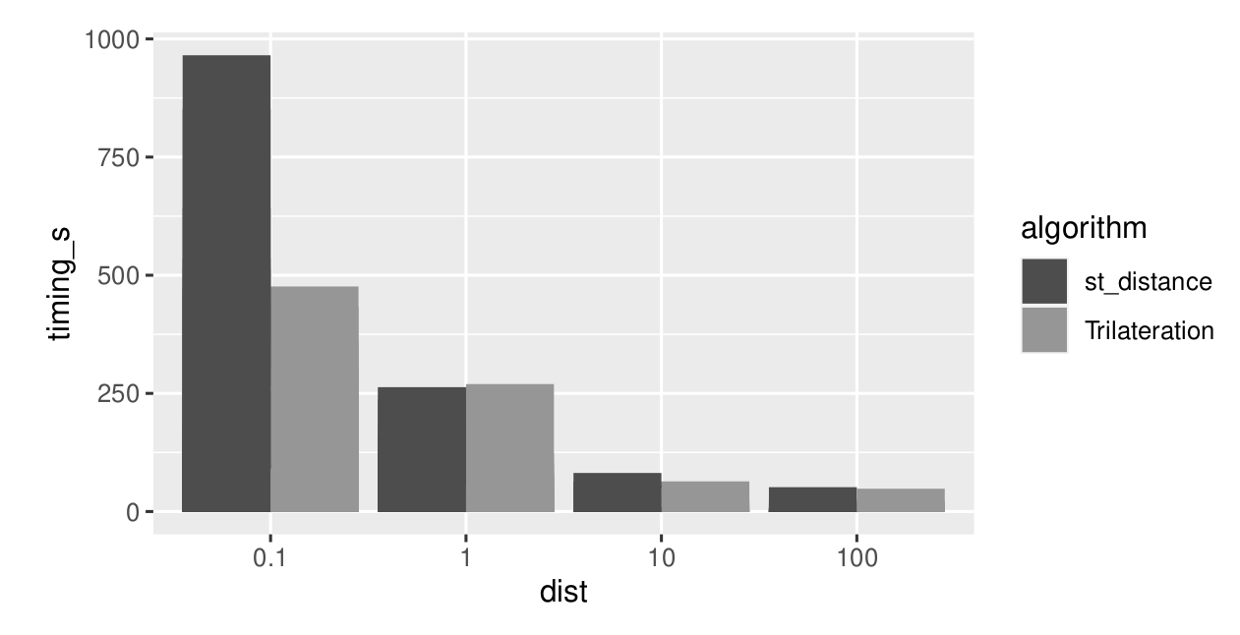
Results
SQL NA Timings:
Good:
50% faster on sparse data (NAP <~ 50%)
Bad:
No major difference for dense data (NAP >~ 80%)

Slide 25
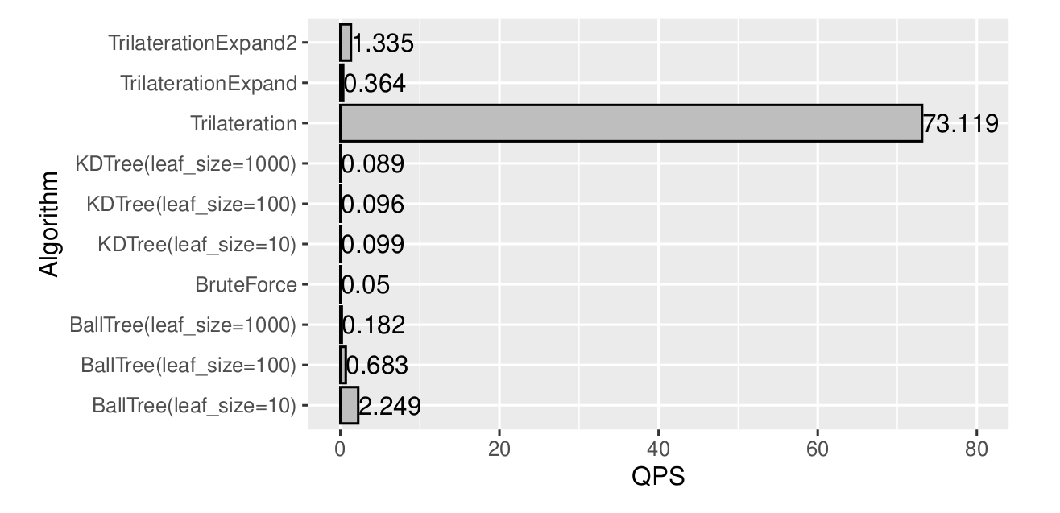
Results
Cython Nearest Neighbor
Good:
50x faster on Geodesic Nearest-Neighbor queries than other algorithms
Also fast pre-processing times not included in the 50x value
Bad:
Horrible performance on Euclidean and other simple distance functions

Slide 26
Conclusions &
Future Work
Objectives Met!
The Good:
We were able to improve performance in SQL and Scikit-Learn for complex distance functions
We are reasonably optimized for training time, memory space, and insert/move time complexity as well as query performance
But nothing’s perfect...
We did NOT create a magical algorithm that improves in the universal case, but we have good bounds on where our algorithm will be useful in advance

Slide 27
Conclusions &
Future Work
So many things...
There are many, many avenues of research we think this opens up for future work:
This is new code and can likely be optimized:
Parallelization should be easy but distributed computing versions were not implemented here for compatibility with our testing libraries
Precision is extremely high; in fact with 64-bit distances and meter units, we are precise to atomic levels measuring on earth. This is unnecessary and probably slows us down.
The Index values themselves have other uses…
These can be used as an alternate coordinate system instead of Lat/Long
“Geohashing” based on Trilateration distances could be valuable
Search for other domains with complex distance functions:
Protein folding? Recommendation Systems? Cryptography?
Non-metric space applications?

Slide 28
Fin

